Slide 1
Gesture Recognition for Prosthetic Control

Slide 2
What and Why?
This study focuses on recognizing patterns of five specific hand gestures using: sEMG and Flex sensor signals
sEMG (surface electromyogram) signals measure electrical activity of muscles.
Flex sensor signals measure muscle contraction and bending movements.
The gestures are replicated by an artificial prosthetic wrist using a trained Artificial Neural Network (ANN).
The hand is a critical grasping organ; improve gesture recognition accuracy.

Slide 3
Definitions
Gesture – is a form of non-vocal communication system
Gesture recognition – is a mathematical interpretation of a human motion by a computing device.
Electromyogram signals (EMGs) – tiny electric signals generated by muscles when they move.
Usually no delay between hand movement and muscle movement so EMG represents the running activity of the hand.
Its amplitude is directly proportional to grip strength.
Flex Sensor signals – signals from flex sensors, which are devices that physically measure how much a body part (like your fingers) bends or moves.

Slide 4
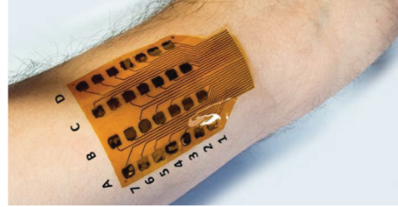

Definitions cont.
Surface or non-invasive electrodes – are used to detect the myoelectric signal that is produced during the contraction of the muscles
Artificial Neural Network (ANN) – are used to classify hand gestures help with problems like identifying hand movements (left, right, etc.) and predicting gestures more accurately.

Slide 5
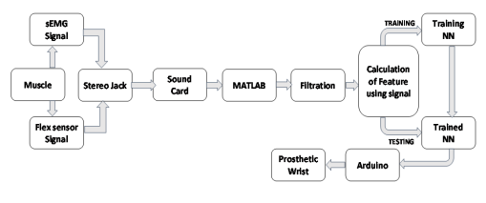
Methodlogy

Slide 6
Methodlogy: Data Collection
25 healthy men without a wrist
Flexor carpi radialis tendon and brachioradialis muscles – superficial and directly involved in wrist and finger gestures.
Five specific hand gestures analyzed: flexion by grabbing all fingers, flexion by grabbing all but the index finger, flexion by grabbing all but the thumb, flexion by grabbing only the thumb and resting state of all fingers.
Each gesture recorded for 6 seconds. First 3 seconds: Calibration i.e. recording baseline signal during a resting period and the last 3 seconds is for gesture capture.

Slide 7
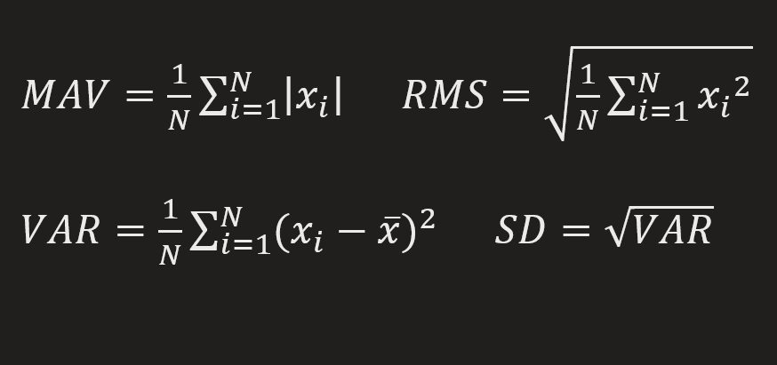
Methodlogy: Data Processing
Signals processed are the raw EMG signals, which are the noisy electrical signals collected from muscles during contraction.
These signals are processed into numerical values for ANN to analyze.

Slide 8
Methodlogy: Classification
ANN mimics the brain's ability to process information in parallel hence the name Artificial Neural Network.
ANN has three layers:
Input Layer – Receives the calculated features from the sEMG and flex sensor signals.
Hidden Layer – Processes the data using weighted connections.
Output Layer – Produces classification results for the hand gestures.
a feed-forward network with backpropagation algorithm was employed.
Data was divided:70% for Training, 15% for Testing, 15% for validation.

Slide 9
Conclusion and take-homes
The paper was a novel approach for implementing hand gestures using an artificial prosthetic wrist by combining both myosignal (sEMG) and muscular contraction level (flex sensor signals).
The training and testing accuracy is better when both sEMG and flex signals are used for healthy person. ut for the disabled person no significant change has been found using flex signal during.
Take-homes:
Thanksgiving!
Success with healthy individuals offers hope for advancing prosthetic control for disabled users.

Slide 10
Thank you

